Slide 1

“E-commerce website”
Major project presentation
On
Student name:
Sahbaj Ali:190919106096
Nikhil Kumar:190919106074

Slide 2
Contents
Introduction
Problem with exiting system
Proposed solution
Technology used in the system (Methodology)
Data Flow Diagram
Hardware and Software requirements
Impact on society
Conclusion
Future Work
Project Status
References

Slide 3
INTRODUCTION
The term electronic commerce (ecommerce) refers to a business model that allows companies and individuals to buy and sell goods and services over the internet . Ecommerce operates in four
Major market segments and can be conducted over computers, tablets, smartphones , and other smart devices.

Slide 4
From past decades the use of the internet is increasing rapidly .People are getting more and more dependent on the internet for their day-to –day work. An average person spends 1h every day on shopping , according to this , it is proven that shopping is so important in one’s life. The way of of shopping of changing day by day, as many people don’t have time because of their busy schedule . People like to pay for e result in more and ease of living, which results in more and more shipping on the internet. Earlier People like to bugs things physically but because of the hectic schedule, they re buying their requirements from the internet.
online shopping not only provides the customers’ requirements but also provides many features such as cheap rates, easy payment options, flexibility in delivery , easy return , quality etc.one of the best features of online shopping is that it provides all the details and information about the product without requiring any physical presence at the place with just a click of a button.
In this project, we have introduced a fully-fledged e commerce website which also include a product review and blog portal. The website will be at an end-to-end working condition which includes features like and to cart , easy payment option , a database which generates messages to the customer and also stores the data.

Slide 5
Problem with Existing System
Currently, the exiting system is great and have negligible or no limitations. The major problem faced by the exiting system is that cost of maintenance is very high and also the cost of resources thy use for they use for their betterment is high.
Existing systems also have downfall that it is not able to provide a proper review of the product they are selling ; A proper and authentic review portal should be available because currently customer firstly selectors the product on the e-shopping portal and then the customers visit a review portal and then after reviewing they buy it. So, the existing system lack their feature.

Slide 6
Proposed System
The proposed system brings out all the features of a modern fully e-commerce website. The proposed system includes features such as a review portal , a technology news portal in addition to an e-commerce portal. The proposed system is also focused on less capital investment while developing the system and also for maintenance.
The proposed system also solves the problem of customers. The system the process of reviewing the product before buying getting updates about technology and buying products.

Slide 7



Technology used in the system
Fronted – Html, CSS, JavaScript , Bootstrap
Backend- Php
Database –MySQL
Hosting – GoDaddy
Development IDE- vs code

Slide 8
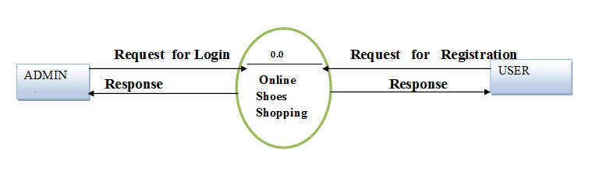
Data Flow Diagram
0 level DFD
The context level data flow diagram (dfd) is describe the whole system. The (o) level dfd describe the all user module who operate the system. Below data flow diagram of online shopping site shows the two user can operate the system Admin and Member user.

Slide 9
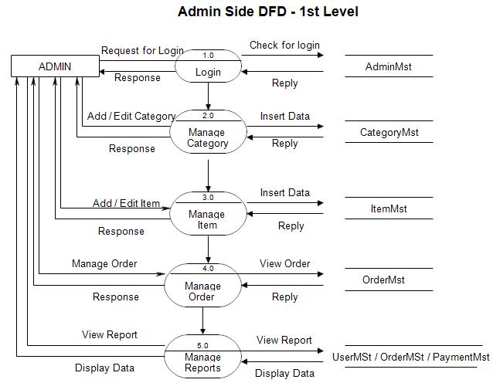
1st Level Admin Side DFD
The Admin side DFD describe the functionality of Admin, Admin is a owner of the website. Admin can first add category of item and then add items by category wise. and admin can manage order and payment detail.

Slide 10
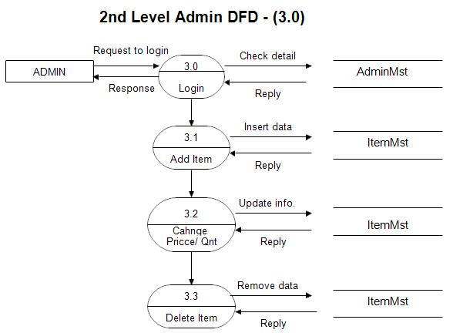

Slide 11
Impact on society
Time Saving
NO need to visit multiple websites
Authenticity of products
Compare with organic reviews

Slide 12
Conclusion
As people are not able to manage extra time from the busy schedule for their day to day work . So they need a quick fix and easy way to solve this problem. The project helps people in getting updated about the technology by news , reviewing the products and buying the products on the same portal. The eases their work of visiting different websites for different stuff. They can save more and more time form three hectic schedule. As said earlier the main motive of the project and the project is base on “shopping made easy” phenomenon.

Slide 13



